Slide 1
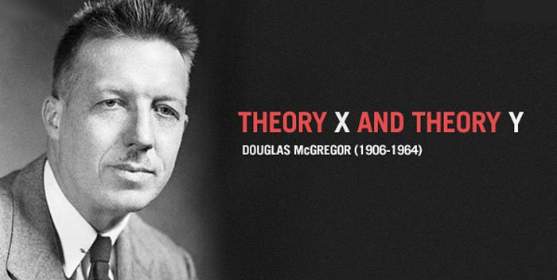
Human resources slide 1

Slide 2

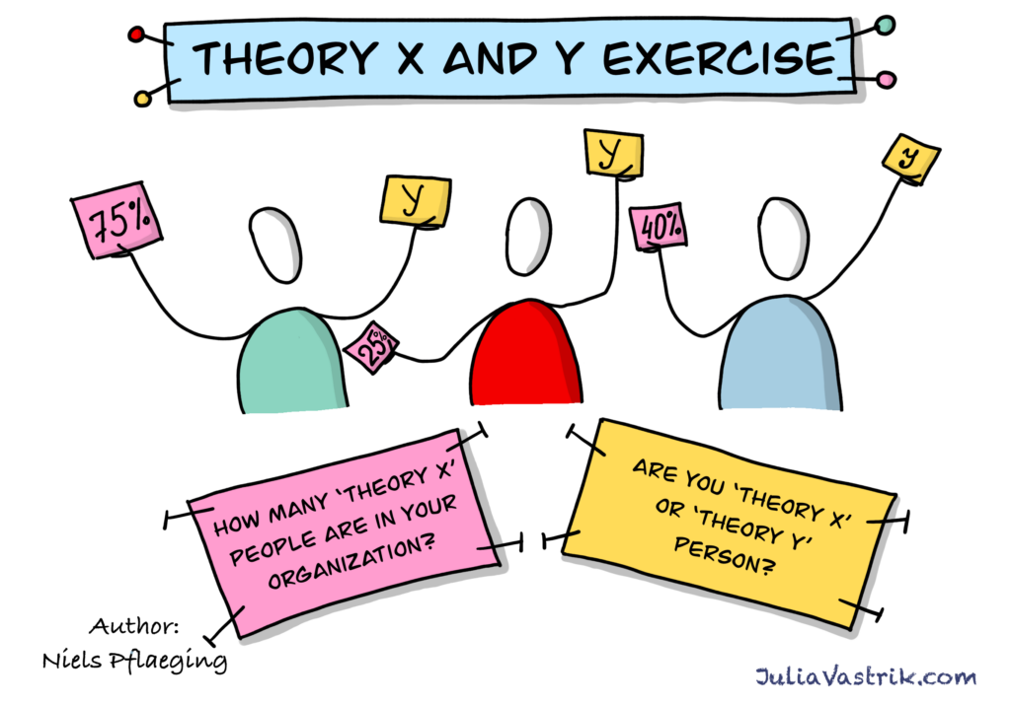
Human resources slide 2
AGENDA
The "agenda" of McGregor's Theory X and Theory Y isn't about specific tasks or steps, but rather the underlying beliefs and assumptions managers hold about their employees' motivations, which in turn shape their management style and the resulting workplace dynamics.

Slide 3
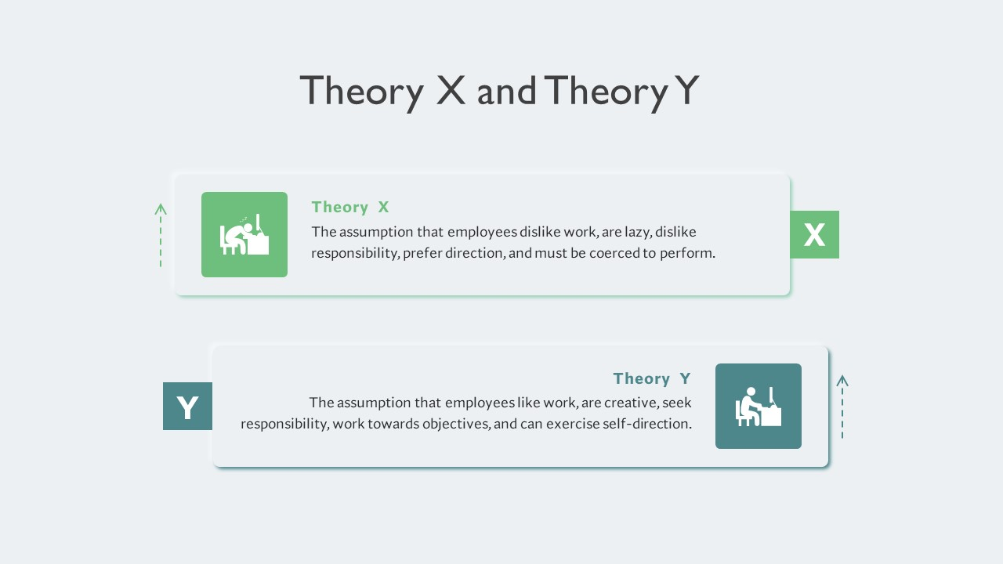
Human resources slide 7

Slide 4
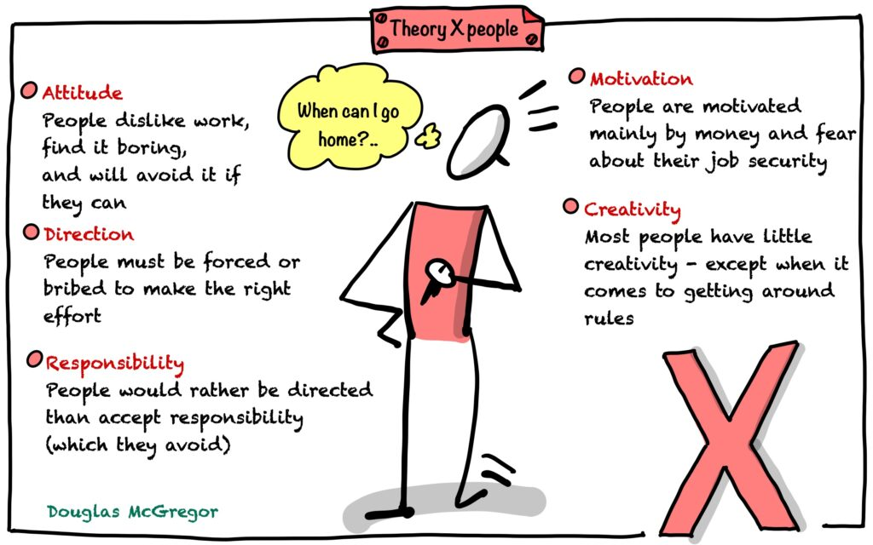
Human resources slide 5

Slide 5
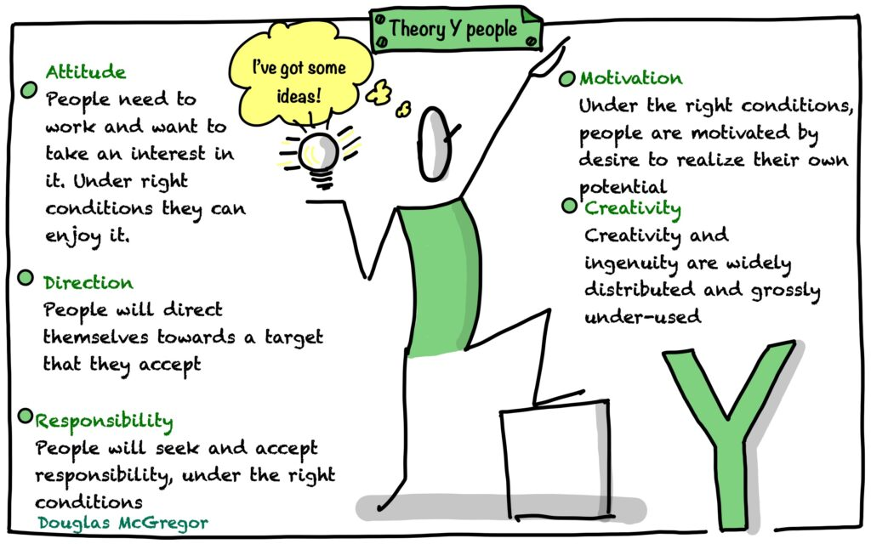
Human resources slide 6

Slide 6
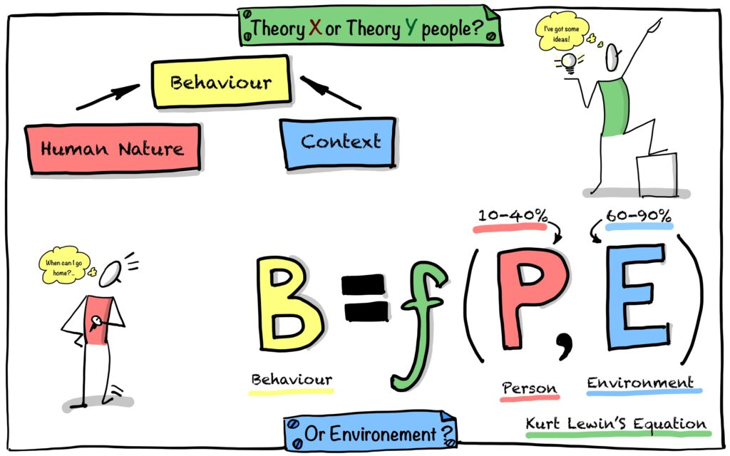
Human resources slide 8
In 1936 Kurt Lewin, German-American psychologist, came up with the behavior equation “B = f(P, E)”.
It states that an individual’s behavior (B) is a function (f) of the person (P), including their history, personality and motivation, and their environment (E), which includes both their physical and social surroundings.

Slide 7


Human resources slide 10
The above discussion has presented McGregor’s Theory X and Theory Y as a unique model for guiding organizational goals and activities. Employees should be aware of the issues, gaps, and strengths associated with it in order to apply it effectively depending on the targeted situation. The ultimate objective is to increase profitability or maximize personal achievements.
Thank You
-By Chinnam. Pravalika

